Slide 1
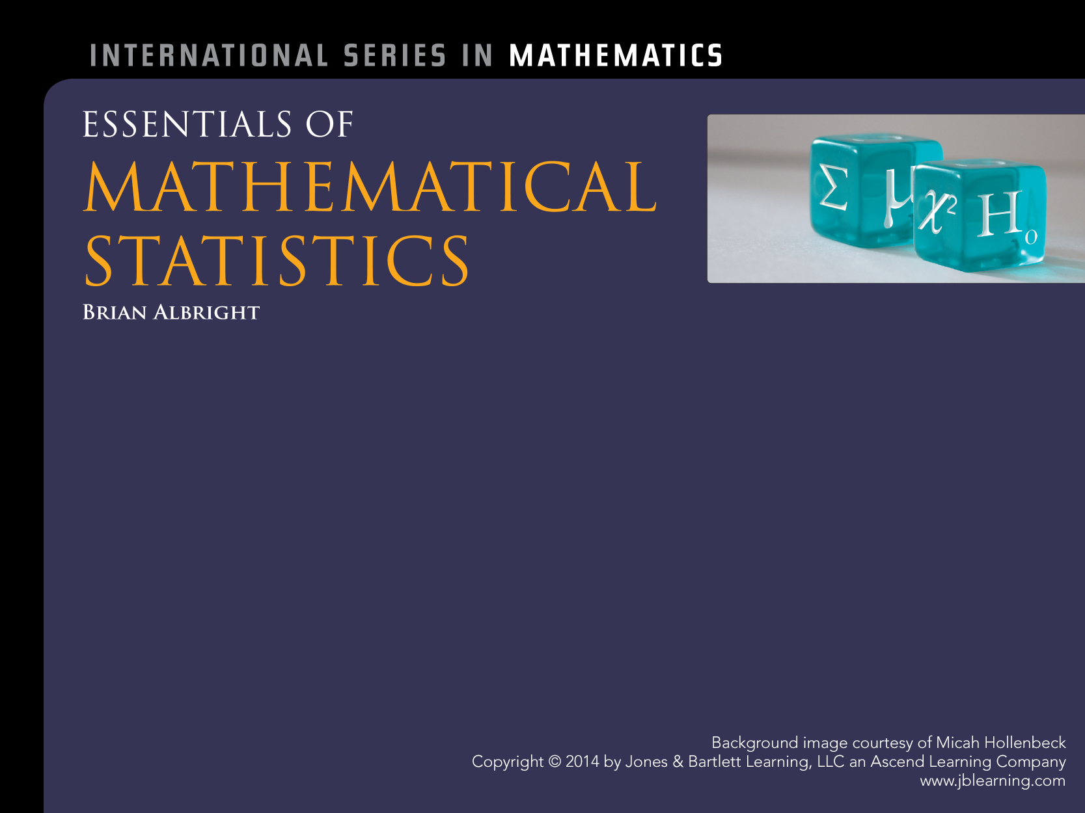
Simple Regression

Slide 2
Introduction
Fundamental questions
Is there a relationship between two random variables and how strong is it?
Can we predict the value of one if we know the value of the other?
Example
The author had ten of his students measure their shoe length and height

Slide 3
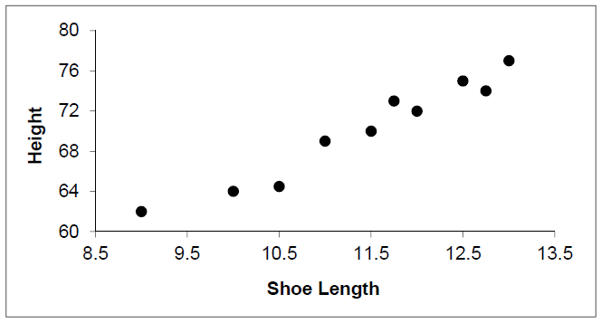
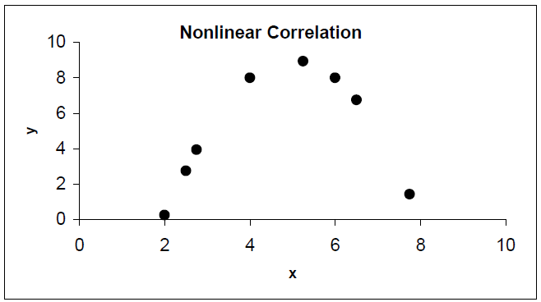
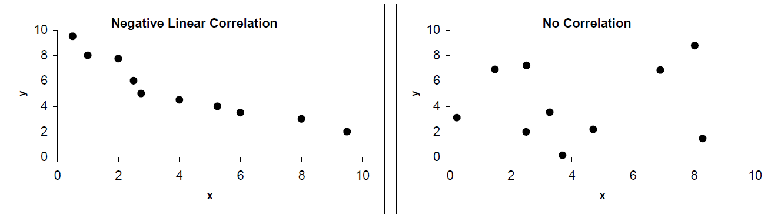
Scatterplot

Slide 4
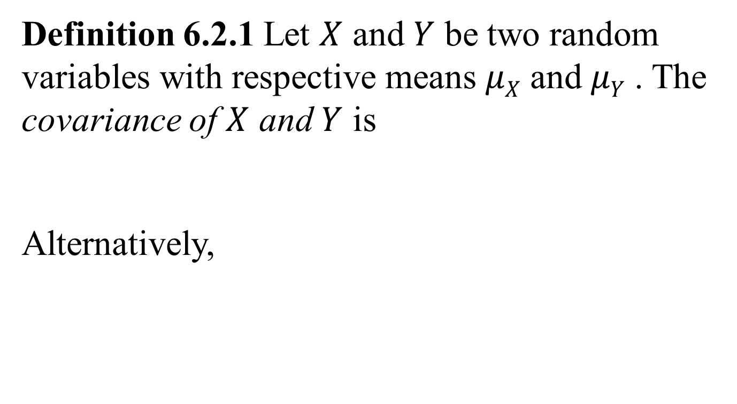
Covariance and Correlation
Definition 6.2.1 Let $X$ and $Y$ be two random variables with respective means $μX$ and $μY$ . The covariance of $X$ and $Y$ is
Alternatively,

Slide 5
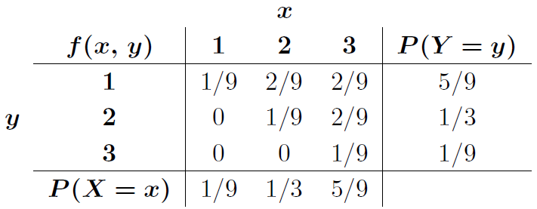
Example

Slide 6

Correlation Coefficient
Definition 6.2.2 Let $X$ and $Y$ be random variables with standard deviations $σX$ and $σY$, respectively. The correlation coefficient of $X$ and $Y$ is
Theorem 6.2.2

Slide 7

Sample Correlation Coefficient
Definition 6.2.3 The sample correlation coefficient of n pairs of data values $\{(x1,y1), …, (xn, yn)\}$ is
Alternatively,

Slide 8
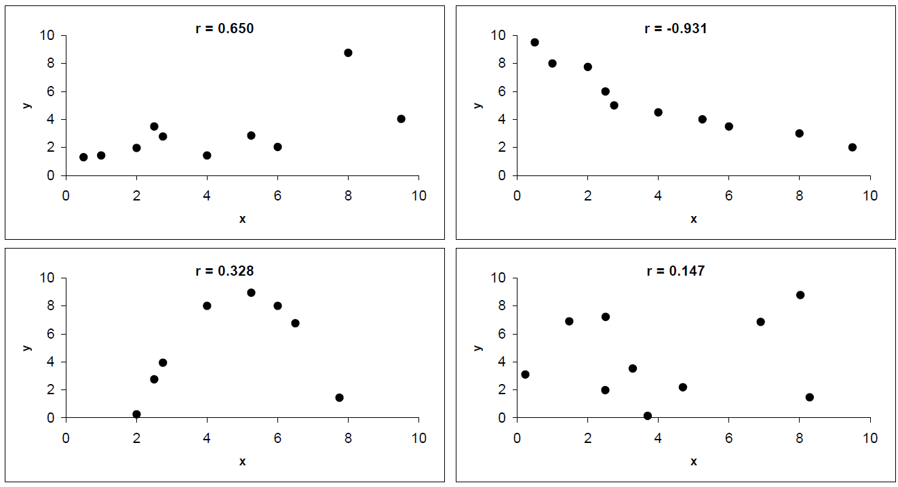
Sample Correlation Coefficient
r measures the strength of a linear relationship

Slide 9
Bivariate Normal Distribution
Definition Let
Two variables X and Y are said to have a bivariate normal distribution if their joint p.d.f. is

Slide 10

Bivariate Normal Distribution
Theorem 6.2.3 Two random variables $X$ and $Y$ with a bivariate normal distribution are independent if and only if $ρ(X,Y)=0$.

Slide 11

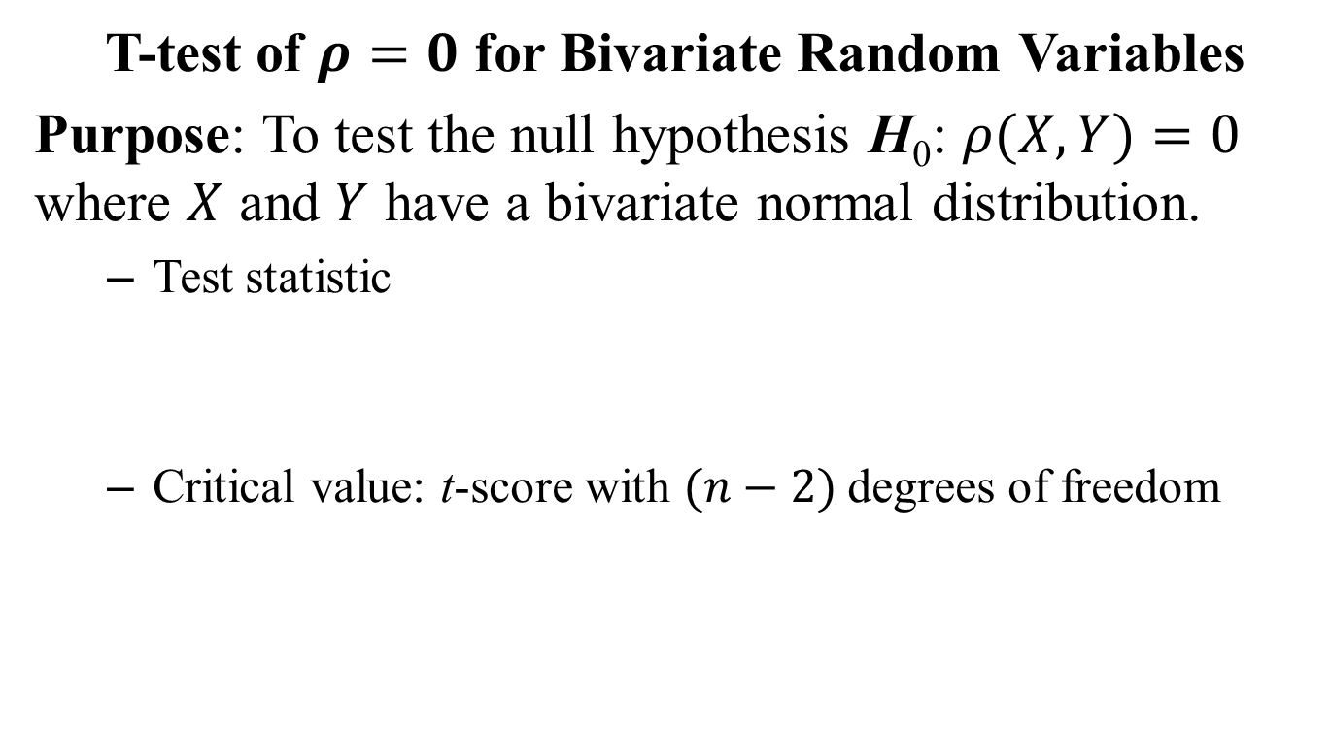
T-test of $ρ=0$
T-test of $ρ=0$ for Bivariate Random Variables
Purpose: To test the null hypothesis H₀: $ρ(X,Y)=0$ where $X$ and $Y$ have a bivariate normal distribution.
Test statistic
Critical value: t-score with $(n−2)$degrees of freedom

Slide 12
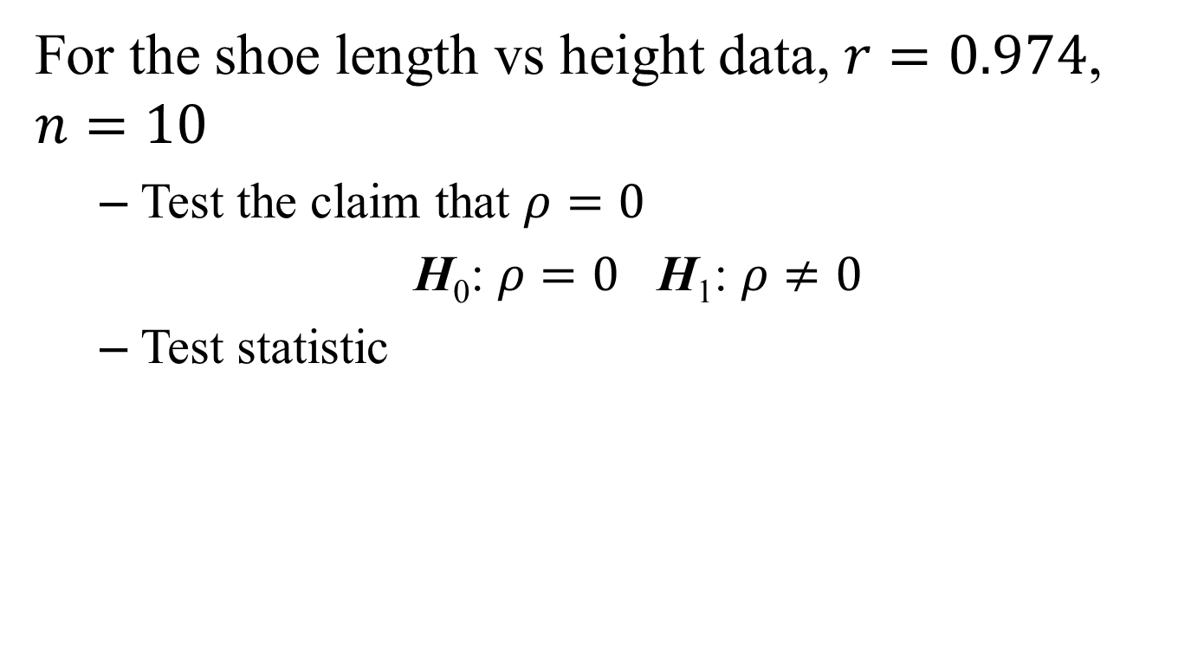
Example
For the shoe length vs height data, $r=0.974$, $n=10$
Test the claim that $ρ=0$
H₀: $ρ=0$ H₁: $ρ≠0$
Test statistic

Slide 13
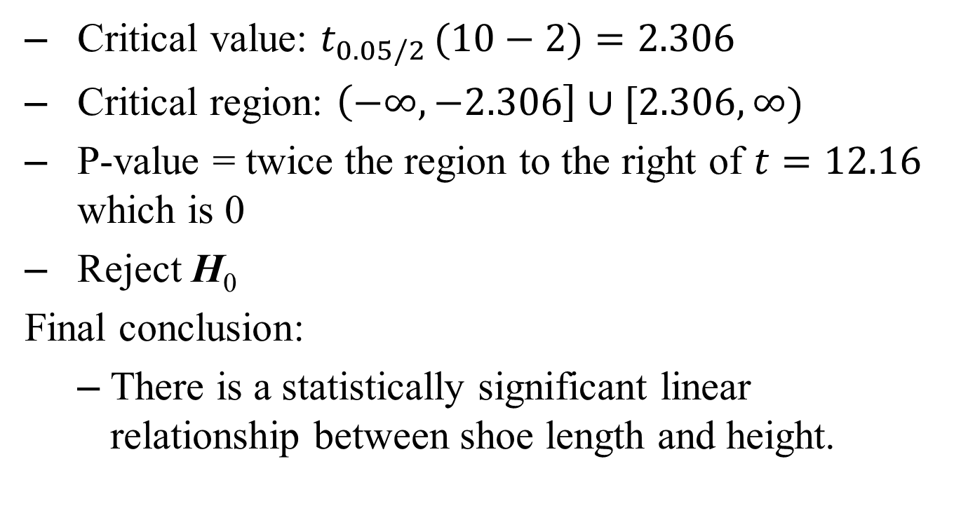
Example
Critical value: $t_{0.05/2} (10−2)=2.306$
Critical region: $\left(−∞, −2.306\right]∪[2.306, ∞)$
P-value = twice the region to the right of $t=12.16$ which is 0
Reject H₀
Final conclusion:
There is a statistically significant linear relationship between shoe length and height.

Slide 14
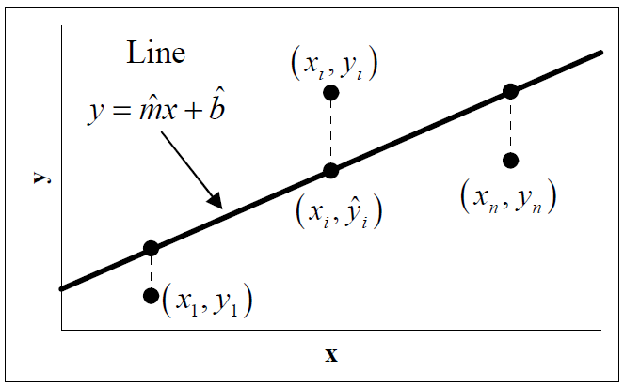

Method of Least-Squares
We want to find $\hat{m}$ and $\hat{b}$ that minimize

Slide 15
Method of Least-Squares

Slide 16
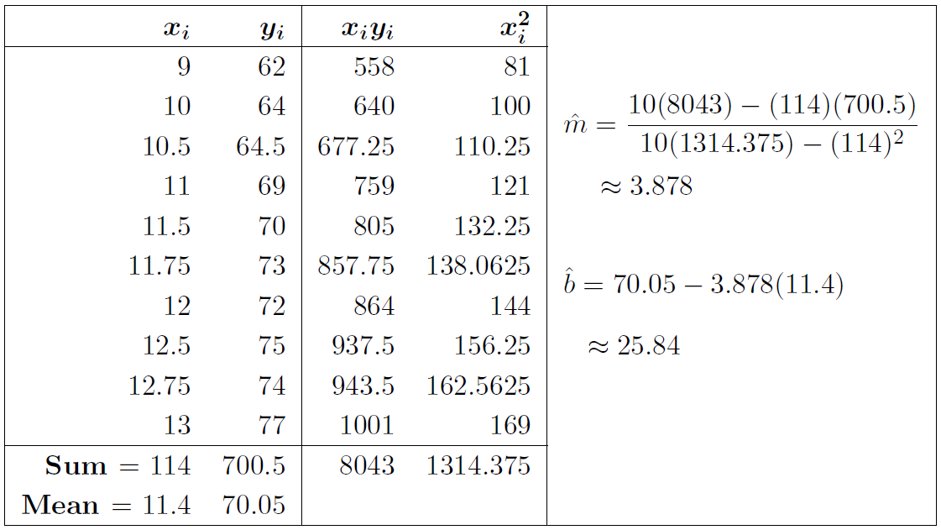
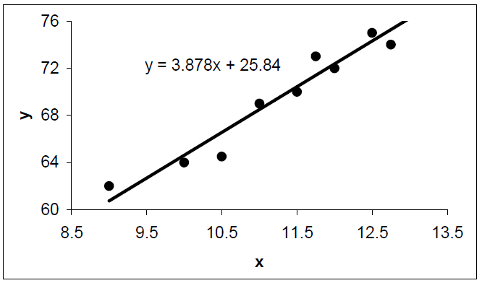
Example

Slide 17
Example
Suppose a crime scene investigator finds a shoe print outside a window that measures 11.25 in long and would like to estimate the height of the person who made the print
Cautions
If there is no linear correlation, do not use a linear regression equation to make predictions
Only use a linear regression equation to make predictions within the range of the x-values of the data

Slide 18
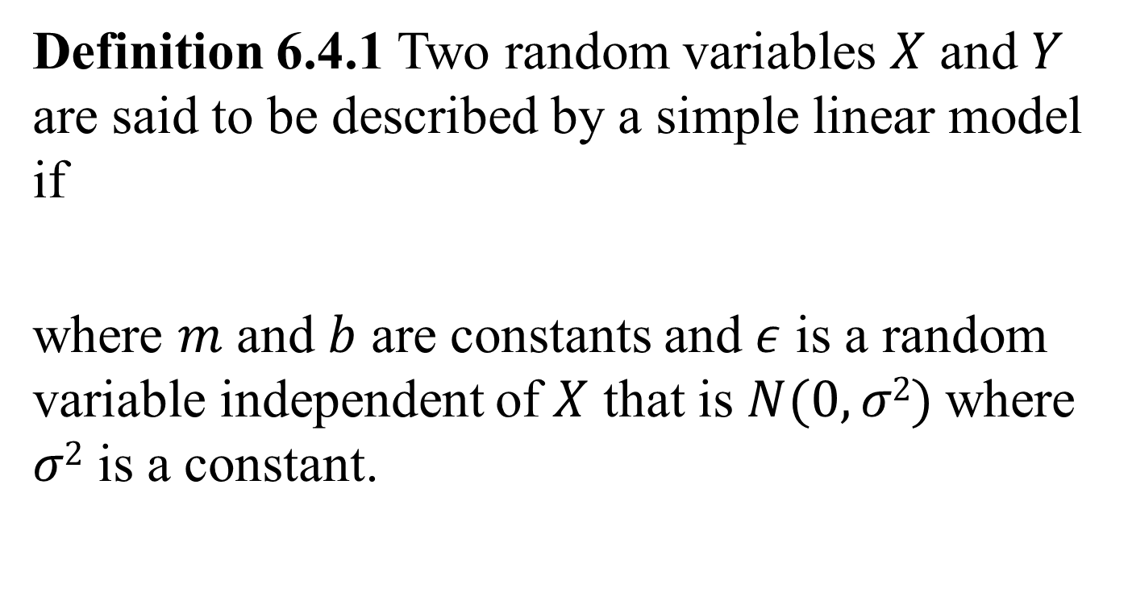
The Simple Linear Model
Definition 6.4.1 Two random variables $X$ and $Y$ are said to be described by a simple linear model if
where $m$ and $b$ are constants and $ε$ is a random variable independent of $X$ that is $N(0, σ2)$where $σ2$ is a constant.

Slide 19
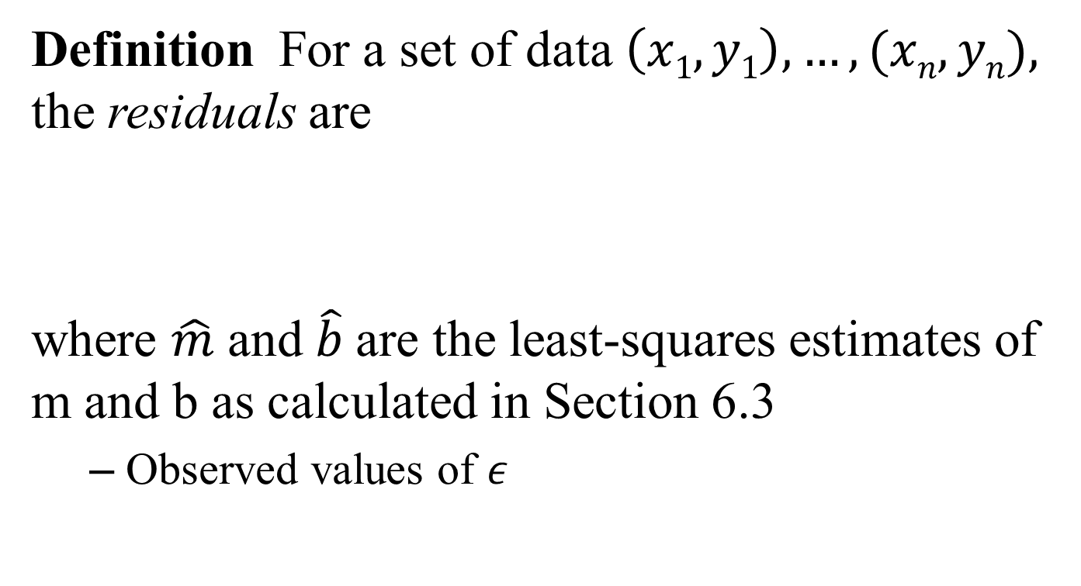
Residuals
Definition For a set of data $\left(x1, y1\right),…, (xn, yn),$ the residuals are
where $\hat{m}$ and $\hat{b}$are the least-squares estimates of m and b as calculated in Section 6.3
Observed values of $ε$

Slide 20
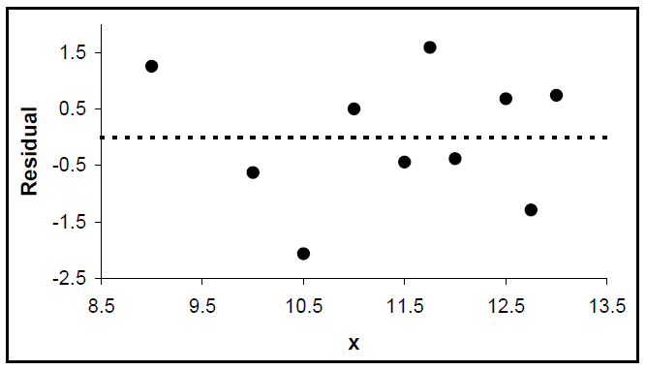
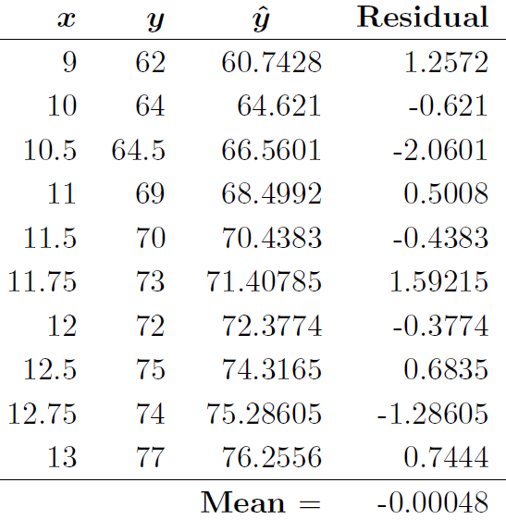
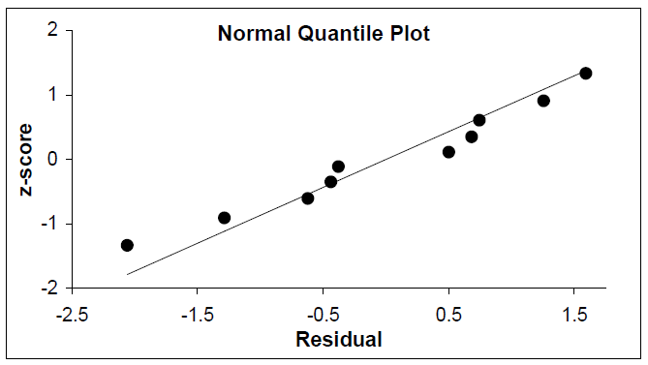
Example

Slide 21
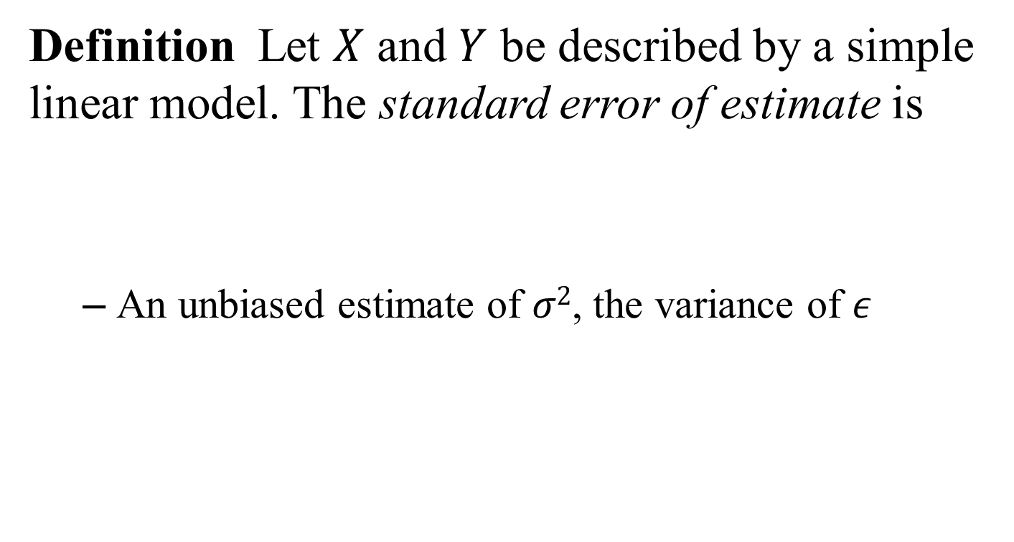
Standard Error of Estimate
Definition Let $X$ and $Y$ be described by a simple linear model. The standard error of estimate is
An unbiased estimate of $σ2$, the variance of $ε$

Slide 22
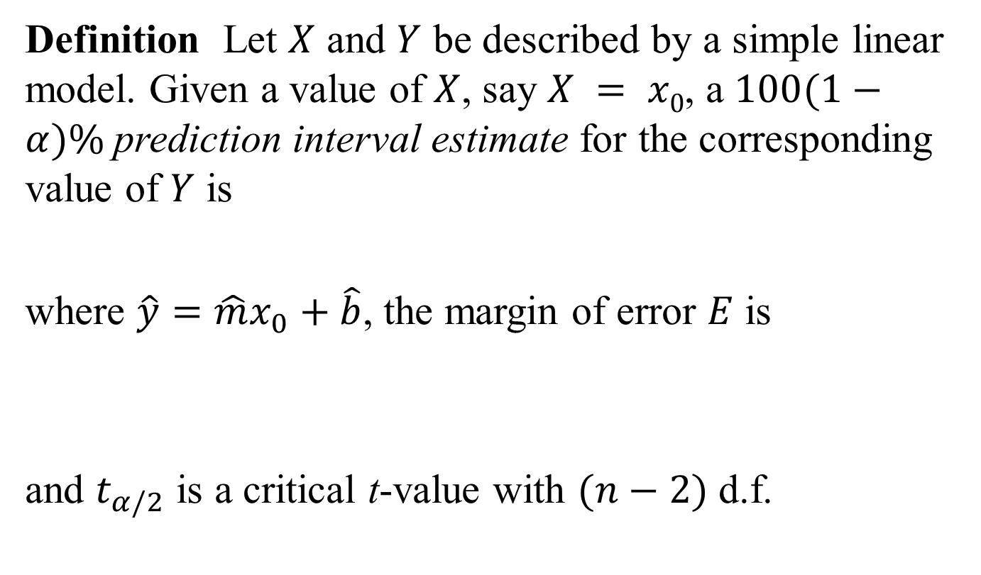
Prediction Interval
Definition Let $X$ and $Y$ be described by a simple linear model. Given a value of $X$, say $X = x0$, a $100(1−α)\%$prediction interval estimate for the corresponding value of $Y$ is
where $\hat{y}=\hat{m}x_{0}+\hat{b}$, the margin of error $E$ is
and $t_{α/2}$ is a critical t-value with $(n−2)$ d.f.

Slide 23

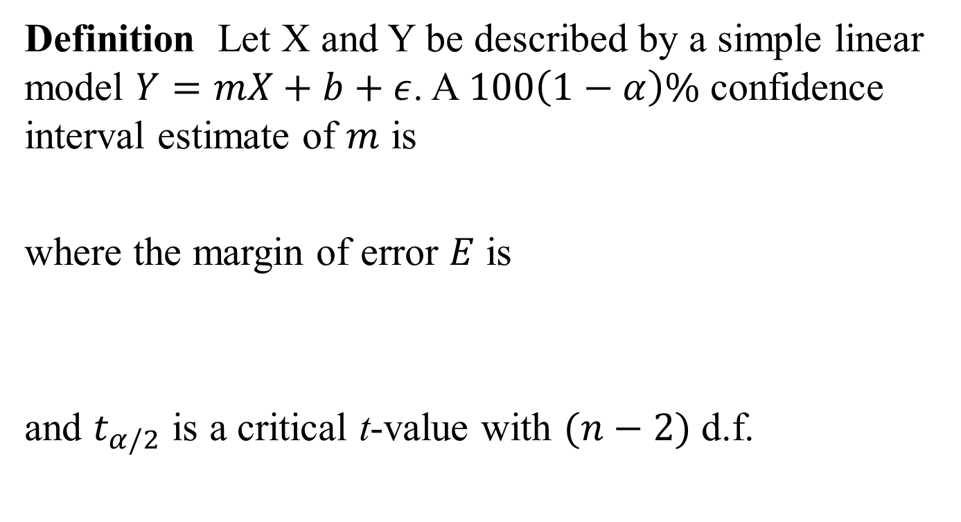
Confidence Interval for $m$
Definition Let X and Y be described by a simple linear model $Y=mX+b+ε$. A $100\left(1−α\right)\%$ confidence interval estimate of $m$ is
where the margin of error $E$ is
and $t_{α/2}$ is a critical t-value with $(n−2)$ d.f.

Slide 24
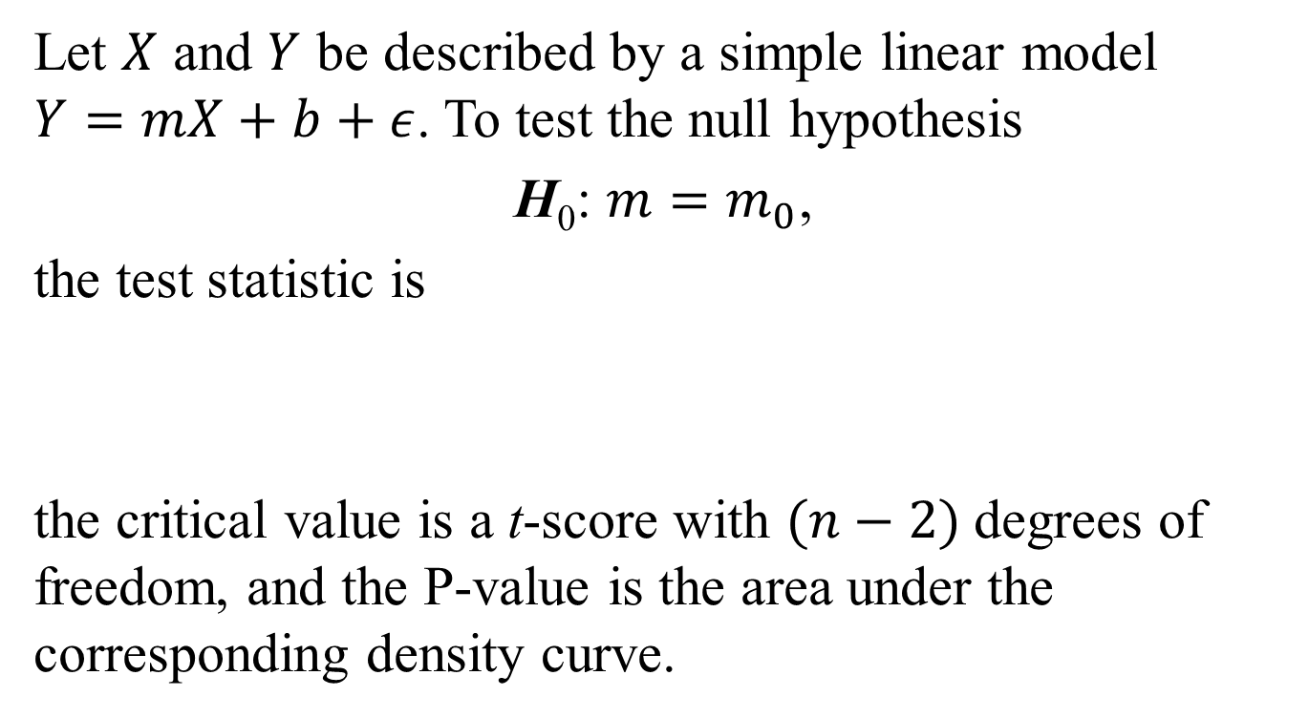
T-Test of the Slope
Let $X$ and $Y$ be described by a simple linear model $Y=mX+b+ε$. To test the null hypothesis
H₀: $m=m_{0}$,
the test statistic is
the critical value is a t-score with $(n−2)$degrees of freedom, and the P-value is the area under the corresponding density curve.

Slide 25
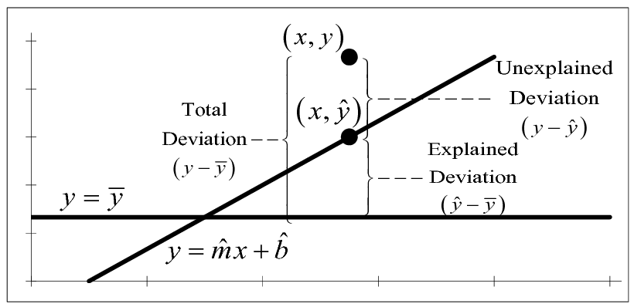
Sums of Squares and ANOVA
Variation

Slide 26
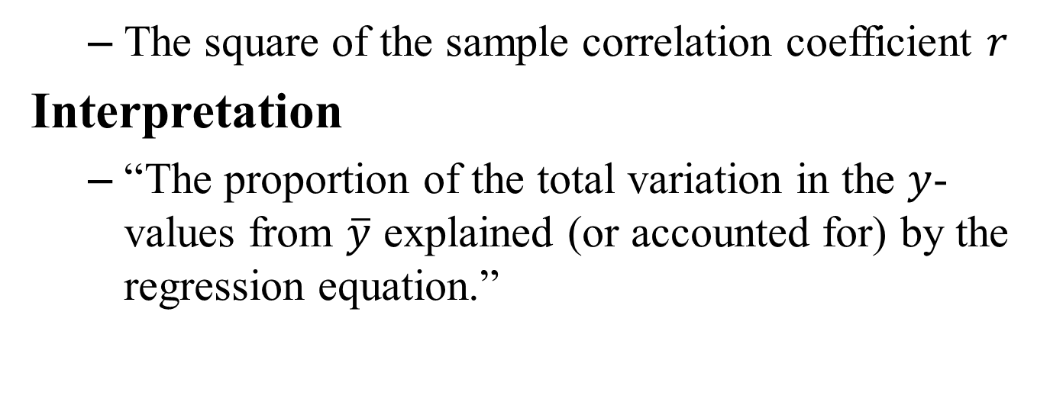
Coefficient of Determination
The square of the sample correlation coefficient $r$
Interpretation
“The proportion of the total variation in the $y$-values from $\overline{y}$ explained (or accounted for) by the regression equation.”

Slide 27
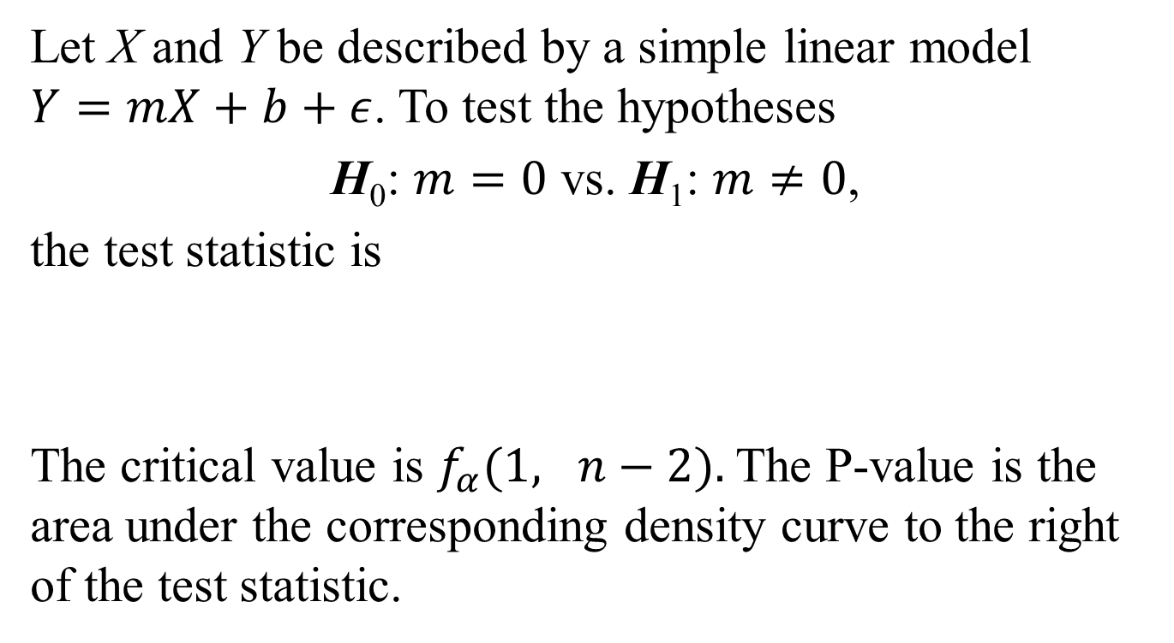
F-Test of the Slope
Let X and Y be described by a simple linear model $Y=mX+b+ε$. To test the hypotheses
H₀: $m=0$ vs. H₁: $m≠0$,
the test statistic is
The critical value is $f_{α}(1, n−2).$The P-value is the area under the corresponding density curve to the right of the test statistic.

Slide 28
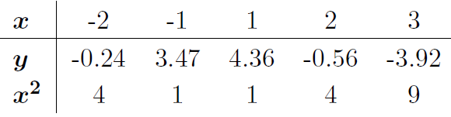

Nonlinear Regression
Example: $X$ and $Y$ are described by $Y=aX2 +b$
Use the data below to estimate $a$ and $b$
$Y$ is linear with respect to $X2$
“Transform” the $x$-values

Slide 29
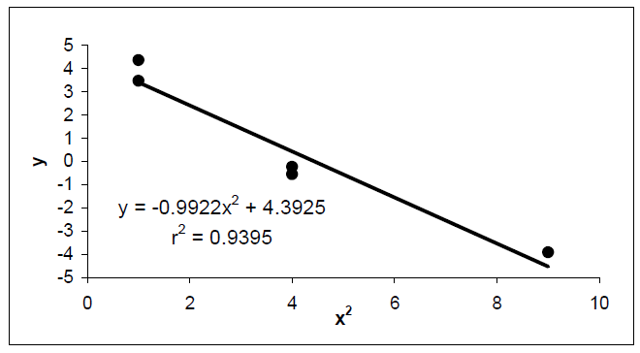
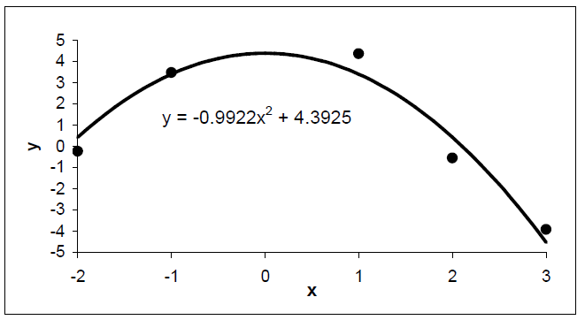
Nonlinear Regression

Slide 30
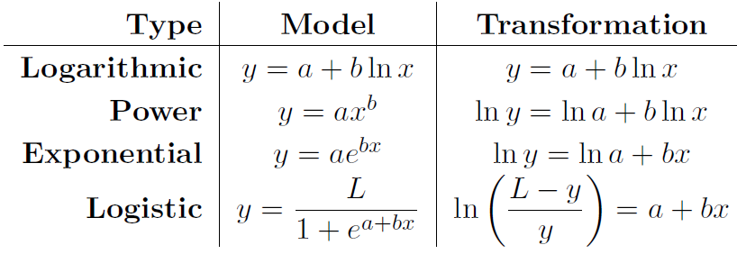
Transformations

Slide 31
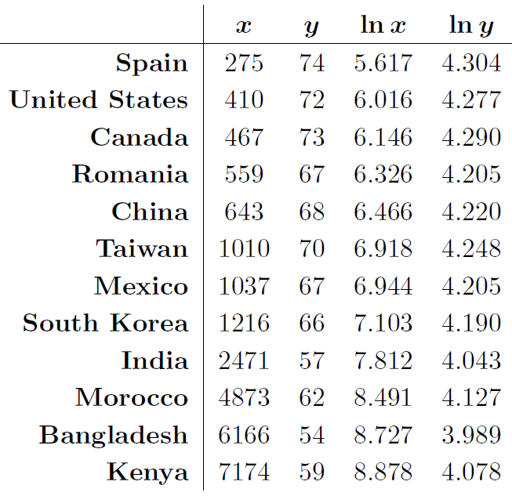
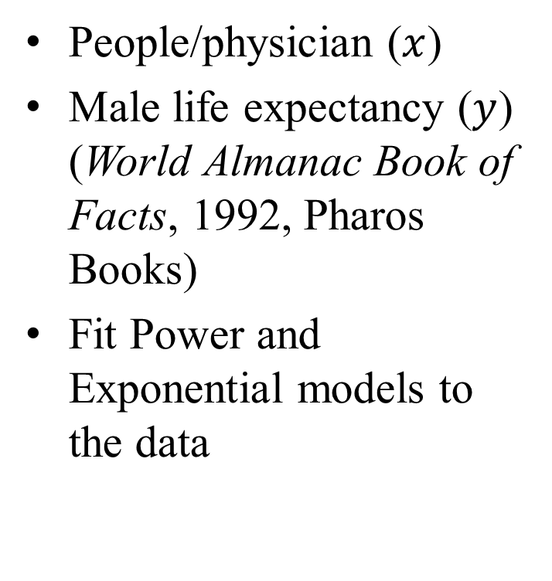
Example
People/physician ($x$)
Male life expectancy ($y$) (World Almanac Book of Facts, 1992, Pharos Books)
Fit Power and Exponential models to the data

Slide 32
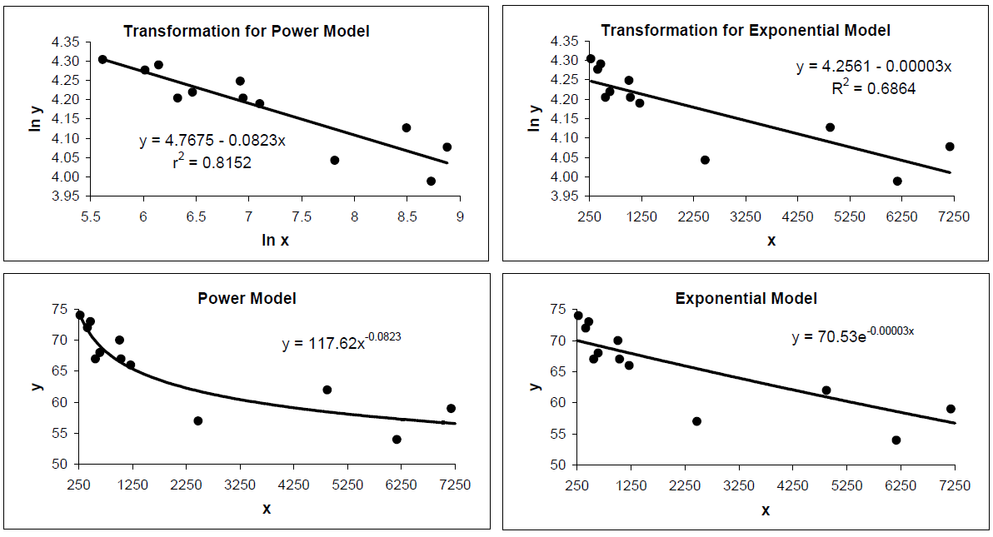
Example

Slide 33
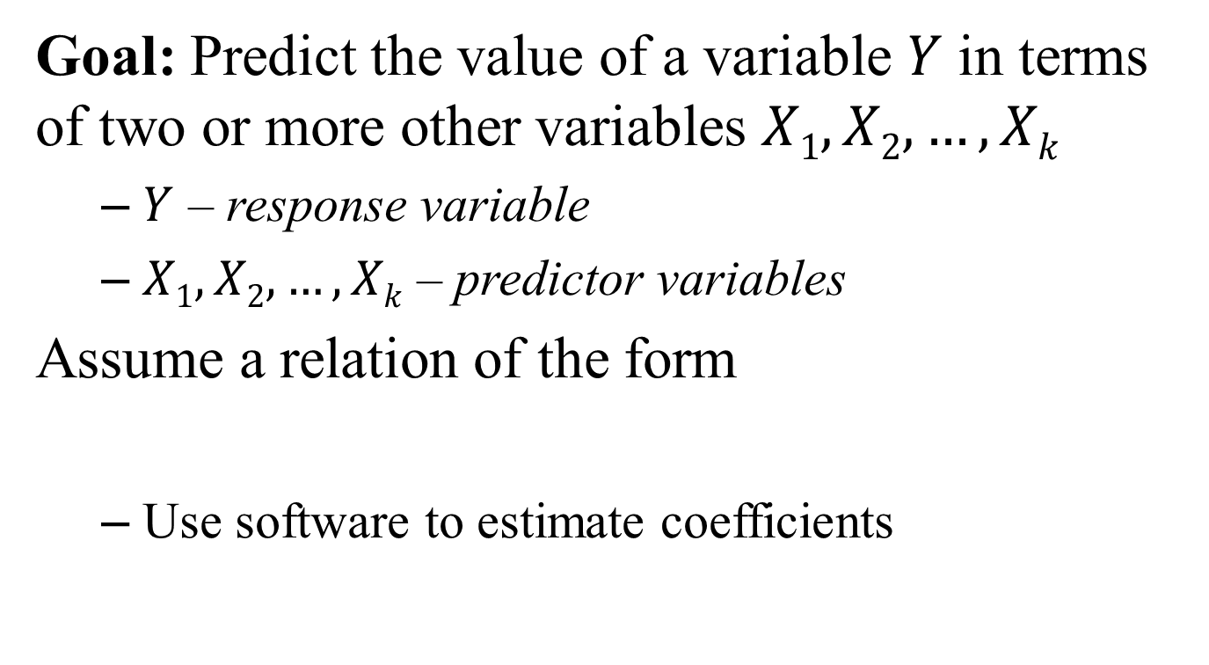
6.7 – Multiple Regression
Goal: Predict the value of a variable $Y$ in terms of two or more other variables $X1, X2, …, Xk$
$Y$ – response variable
$X1, X2, …, Xk$ – predictor variables
Assume a relation of the form
Use software to estimate coefficients

Slide 34
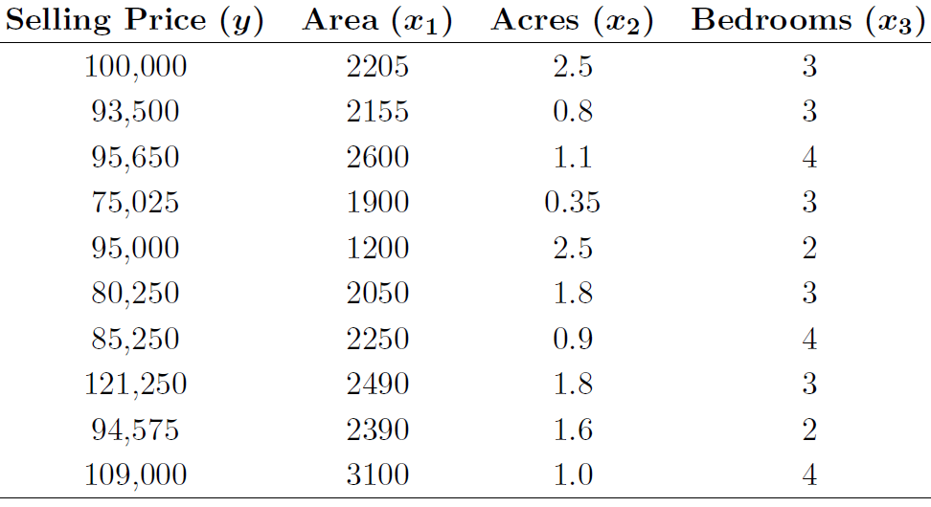
Example
Predict Selling Price in terms of Area, Acres, and Bedrooms

Slide 35
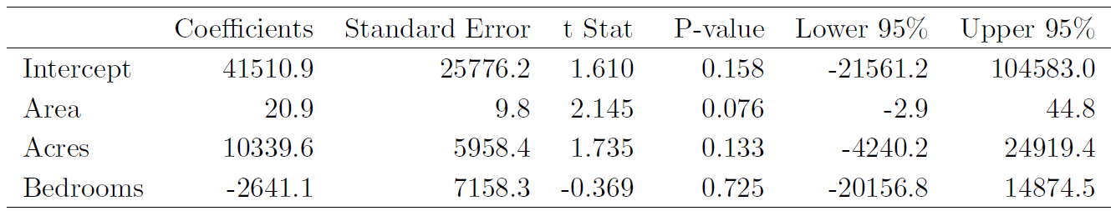
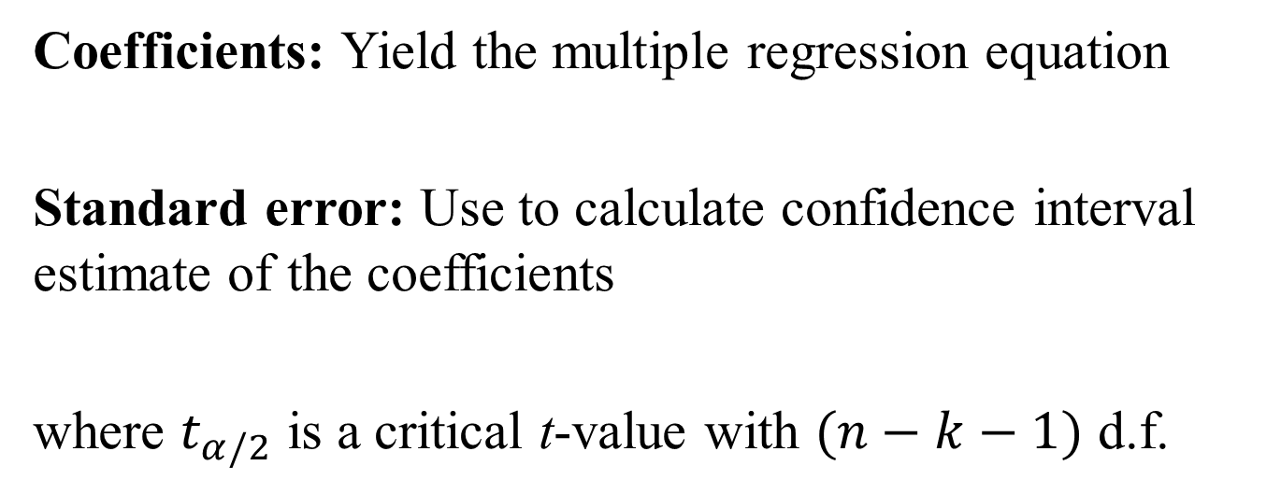
Outputs
Coefficients: Yield the multiple regression equation
Standard error: Use to calculate confidence interval estimate of the coefficients
where $t_{α/2}$ is a critical t-value with $(n−k−1)$ d.f.

Slide 36
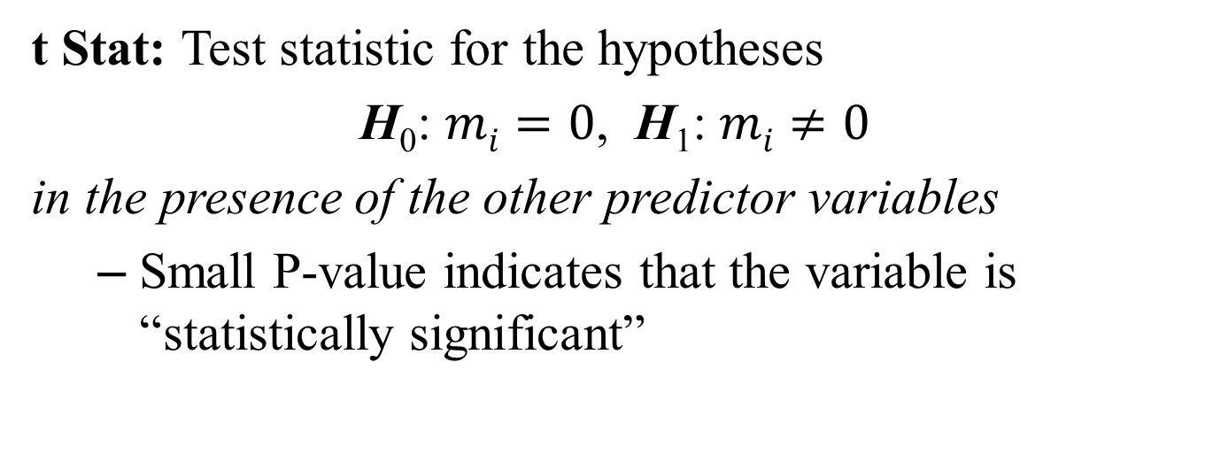
Outputs
t Stat: Test statistic for the hypotheses
H₀: $mi=0$, H₁: $mi≠0$
in the presence of the other predictor variables
Small P-value indicates that the variable is “statistically significant”

Slide 37
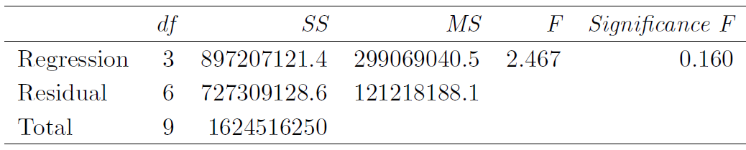
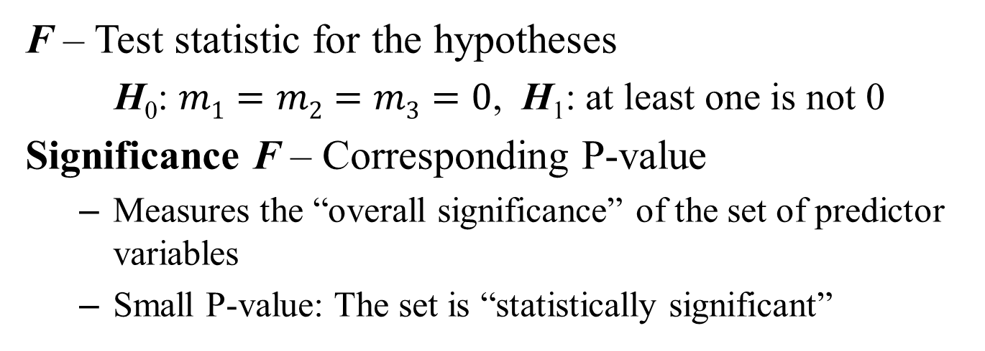
ANOVA Results
F – Test statistic for the hypotheses
H₀: $m1=m2=m3=0$, H₁: at least one is not 0
Significance F – Corresponding P-value
Measures the “overall significance” of the set of predictor variables
Small P-value: The set is “statistically significant”

Slide 38
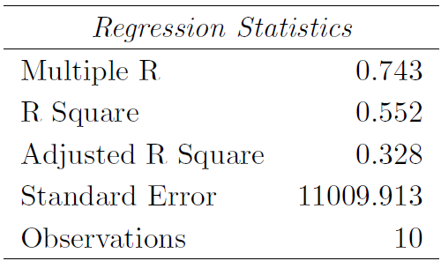
Regression Statistics
Multiple R – Multiple regression equivalent of the sample correlation coefficient r
R Squared – Multiple coefficient of determination

Slide 39
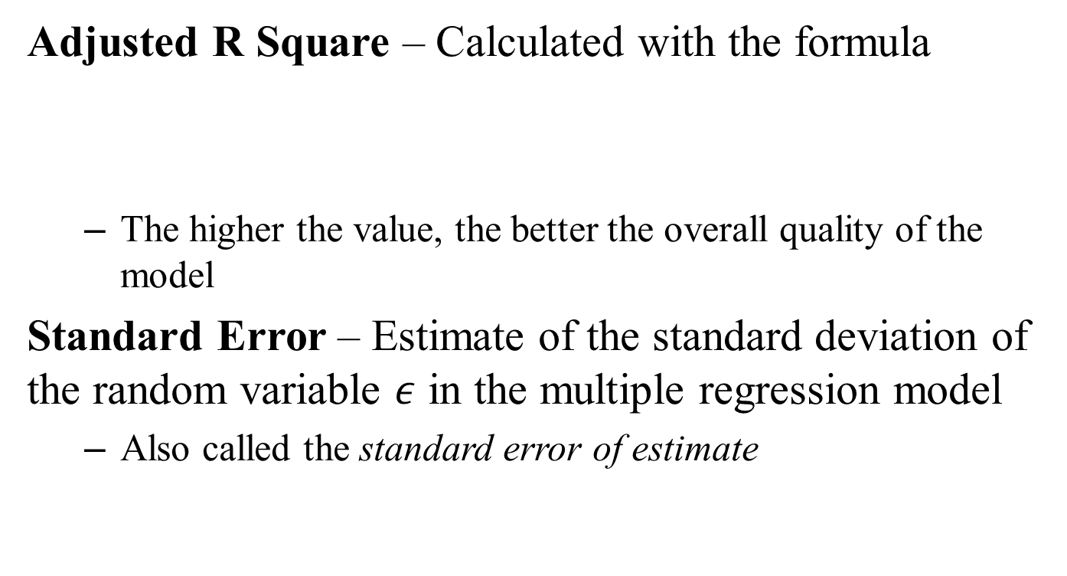
Regression Statistics
Adjusted R Square – Calculated with the formula
The higher the value, the better the overall quality of the model
Standard Error – Estimate of the standard deviation of the random variable $ε$ in the multiple regression model
Also called the standard error of estimate

Slide 40
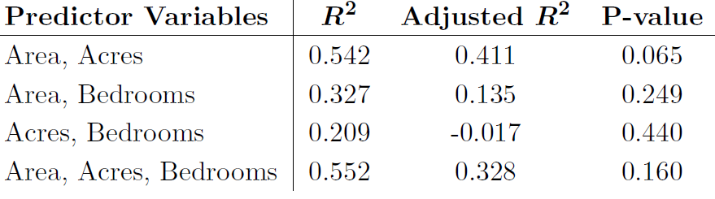

Which Set of Variables is “Best?”
Very complicated to answer
A very simple approach:
Compare $R2$, Adjusted $R2$, and P-values
Area and Acres are “best”

